Slide 1
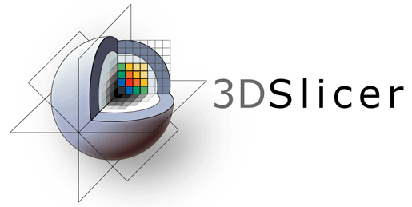
3D Slicer Registration Tutorial

Slide 2
Prerequisites
Please finish the ‘Data loading and visualization’ tutorial before starting this one
Install the SegmentRegistration and SlicerElastix extensions from the Extension Manager

Slide 3
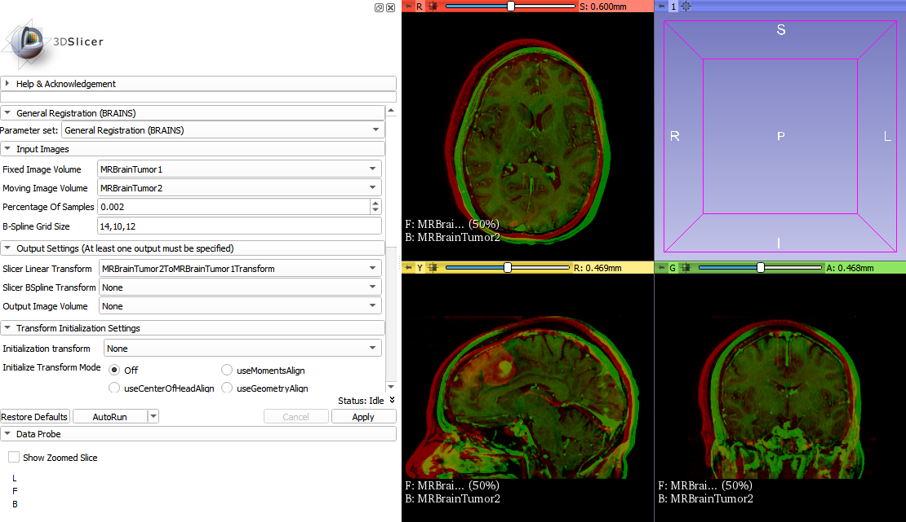
Part 1: Image-based registration with Elastix

Slide 4
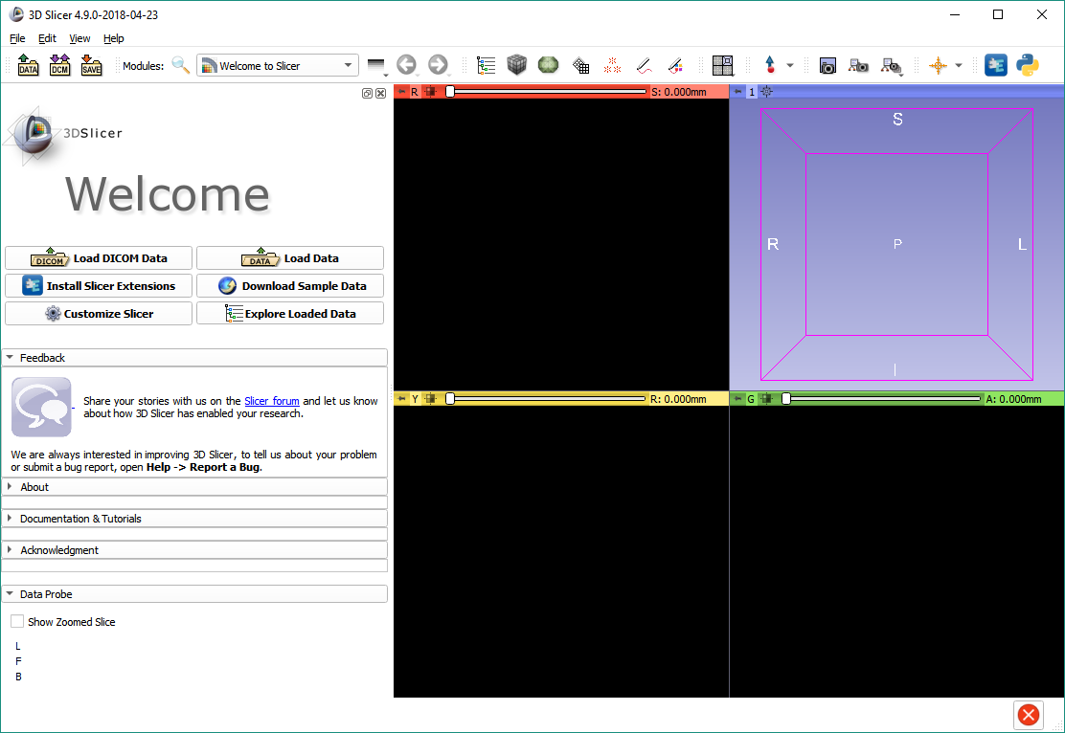

Load sample brain tumor images
Click on the ‘Download Sample Data’ button in the Welcome module.

Slide 5
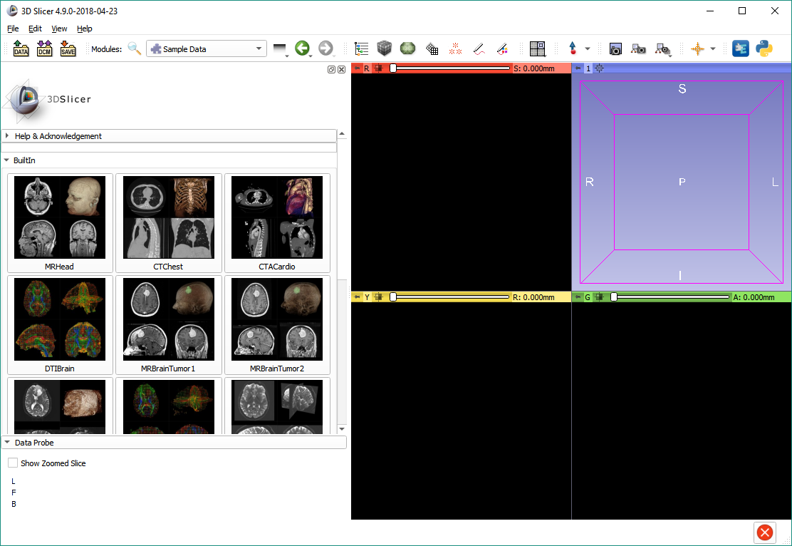
Load sample brain tumor images
Click ‘MRBrainTumor1’ to download the first dataset. Once it appeared, click ‘MRBrainTumor2’ to download the second one.

Slide 6
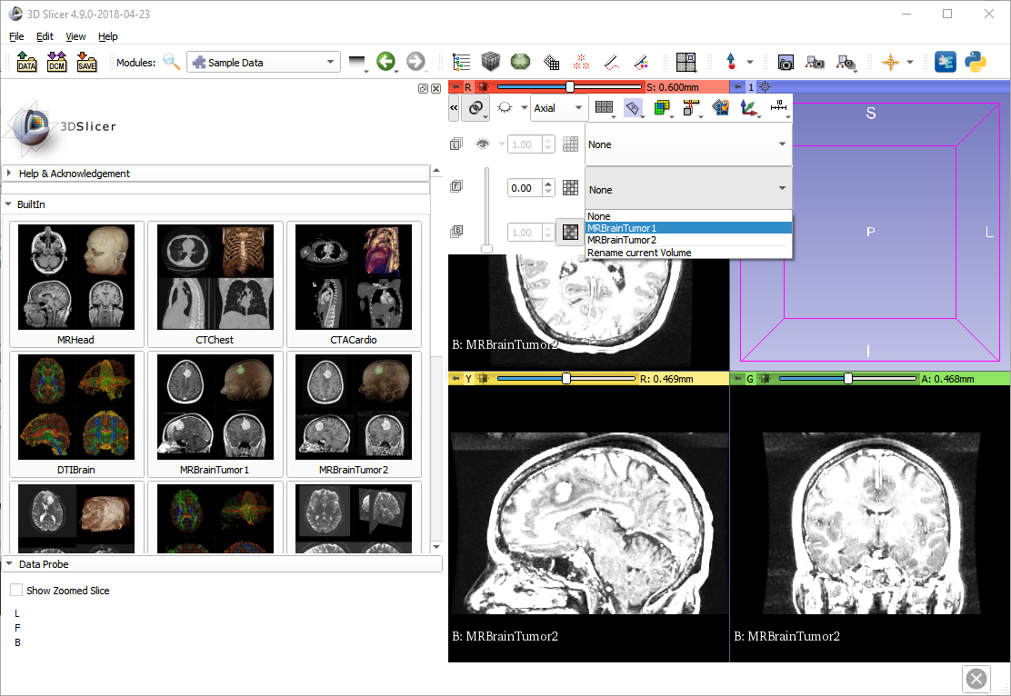
See difference between images
Open the slice view controller by placing the mouse cursor over the pin icon. Click the ‘>>’ button to expand the path selector. Link the views with the link button.
Click the foreground image selector and choose ‘MRBrainTumor1’

Slide 7
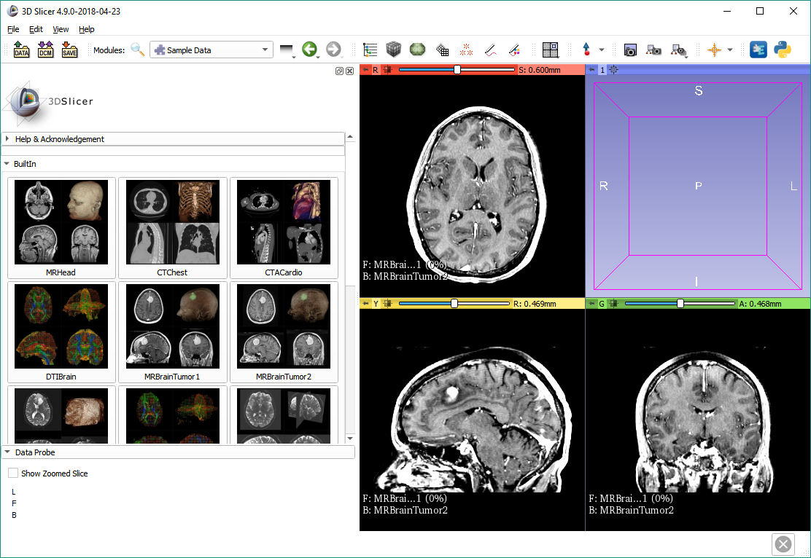
See difference between images
Adjust contrast and brightness (“window width and level”) by holding down the left mouse button on the slice viewer and moving it up/down for window level, and left/right for window width.

Slide 8
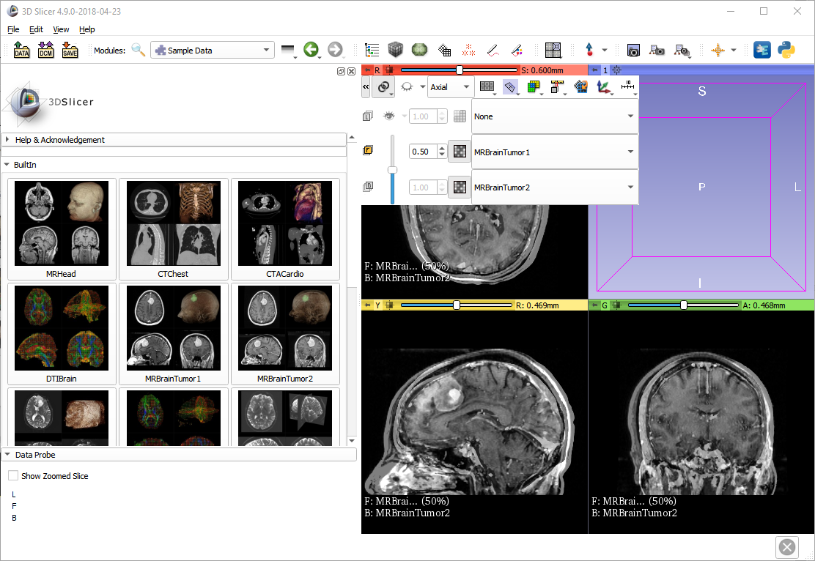
See difference between images
Adjust the opacity slider to see both volumes at the same time.

Slide 9
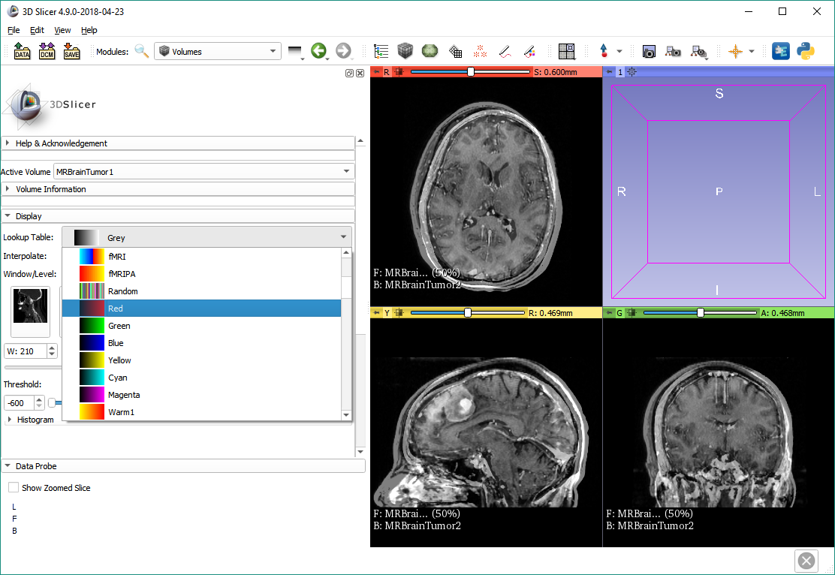
See difference between images
Switch to the Volumes module, then change the lookup table for the first volume to ‘Red’.

Slide 10
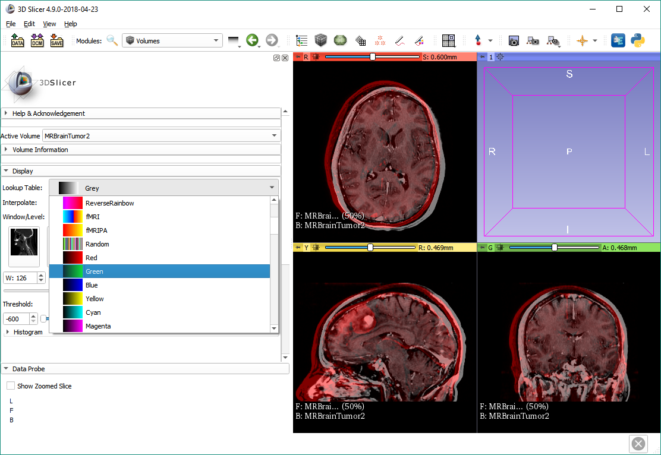
See difference between images
Select the second volume, then change its lookup table to ‘Green’.

Slide 11
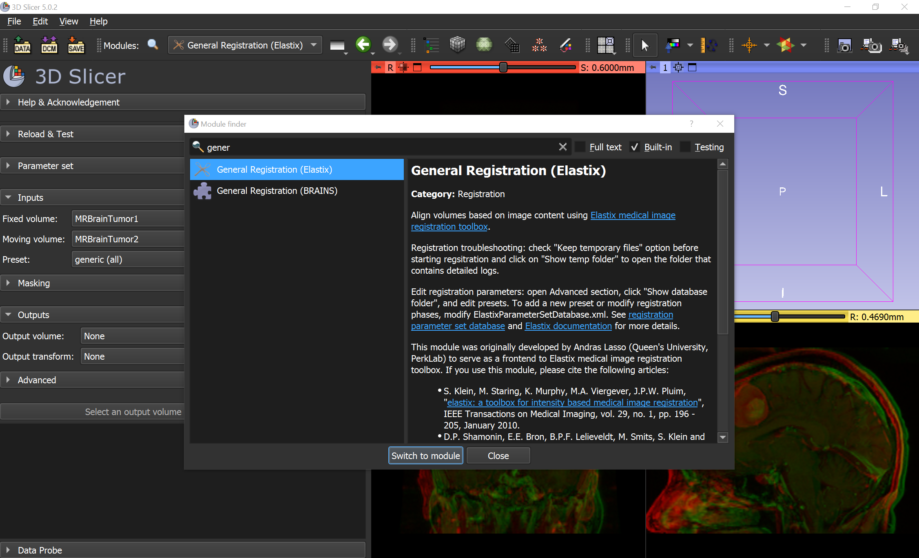
Register image using Elastix
Switch to the ‘General Registration (Elastix)’ module.

Slide 12
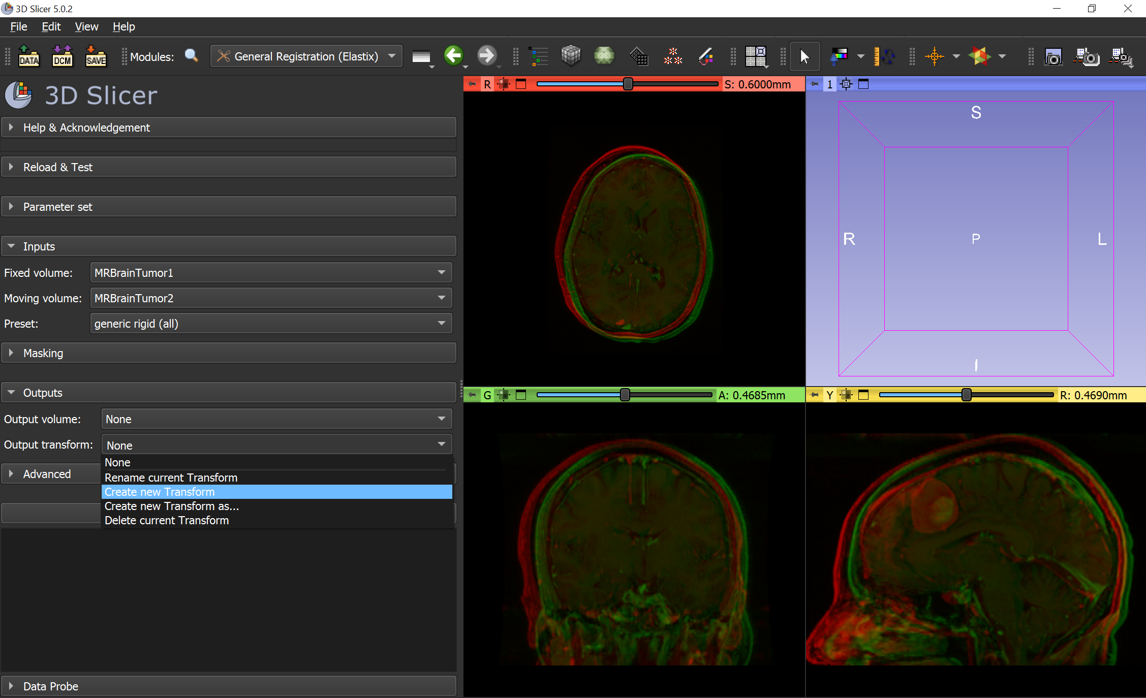
Register image using Elastix
Select Fixed and Moving image volumes, generic rigid (all) preset, then create a new transform for Output transform. Name it as Tumor2ToTumor1.

Slide 13
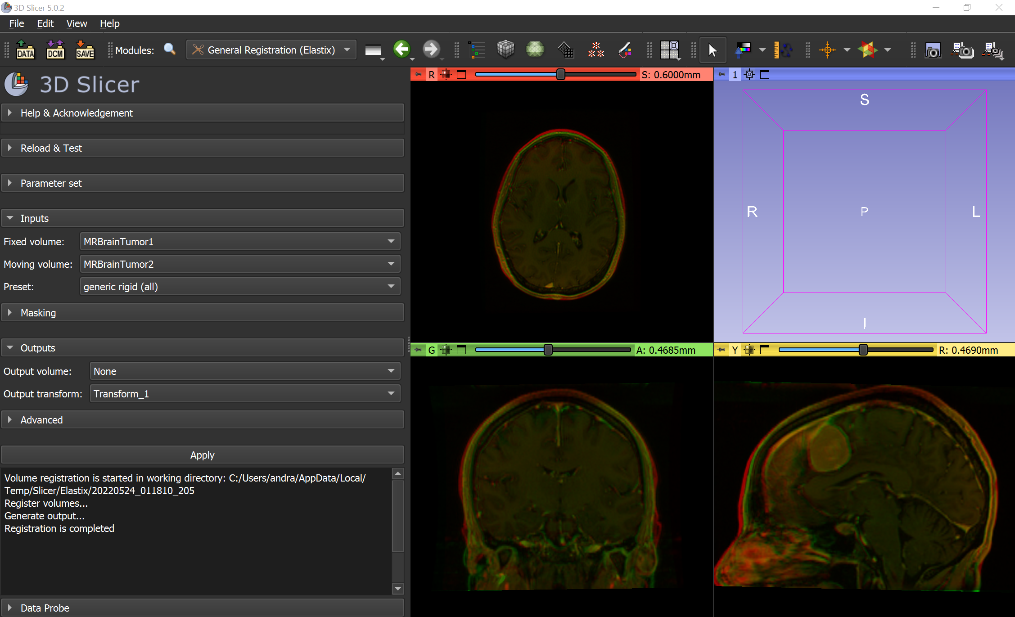
Rigid registration using Elastix
Click Apply to start the registration.

Slide 14
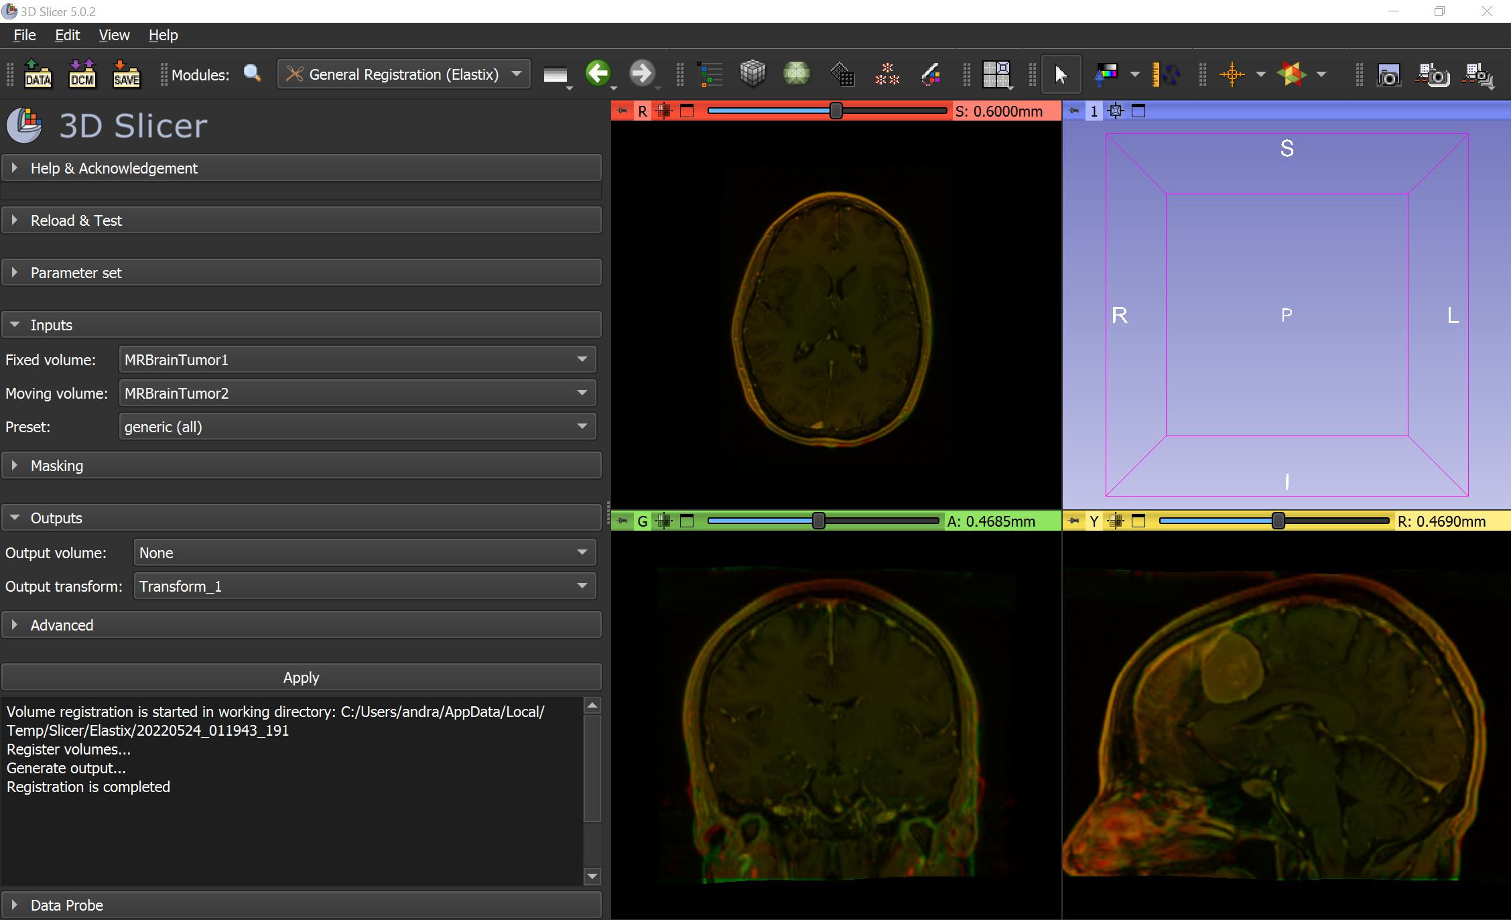
Deformable registration using BRAINS
Select generic (all) preset and click Apply.

Slide 15
Image registration modules
General registration (BRAINS) – in Slicer core
Often works well for brain MRI, but requires tuning for other image types
General registration (Elastix) – in SlicerElastix extension
generic (all) and generic rigid (all) give reasonable result without parameter tuning
Computed transform is stored as displacement field, even if bspline could store it with much less data
General registration (ANTs) in SlicerANTs extension
Usually works without parameter tuning
Parameters can be adjusted using GUI

Slide 16
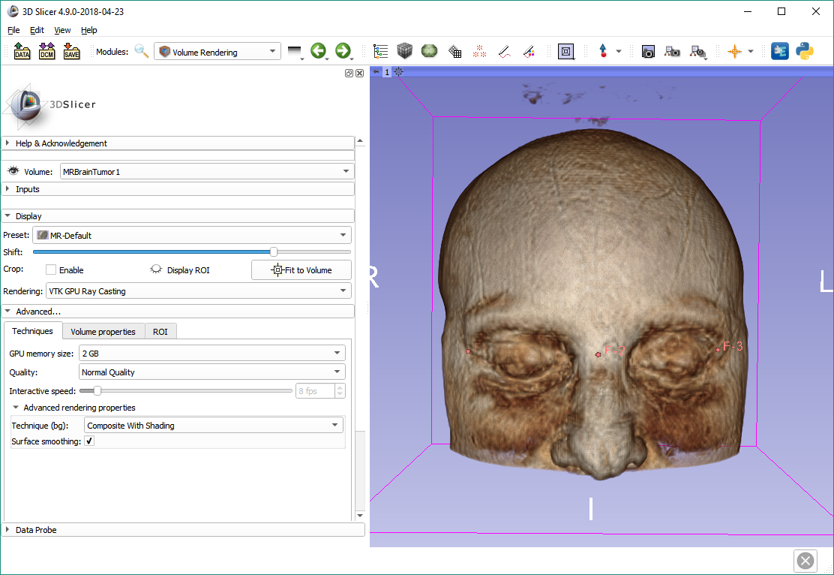
Part 2: Fiducial-based registration

Slide 17
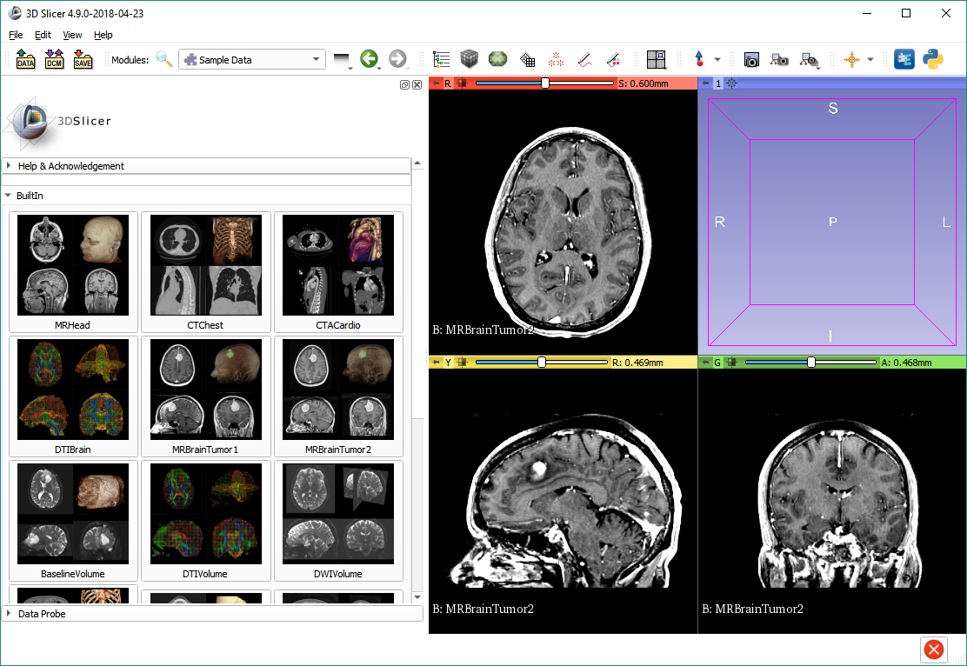
Restart workflow
Close the scene (see File menu), and load the two sample brain tumor images once more.

Slide 18
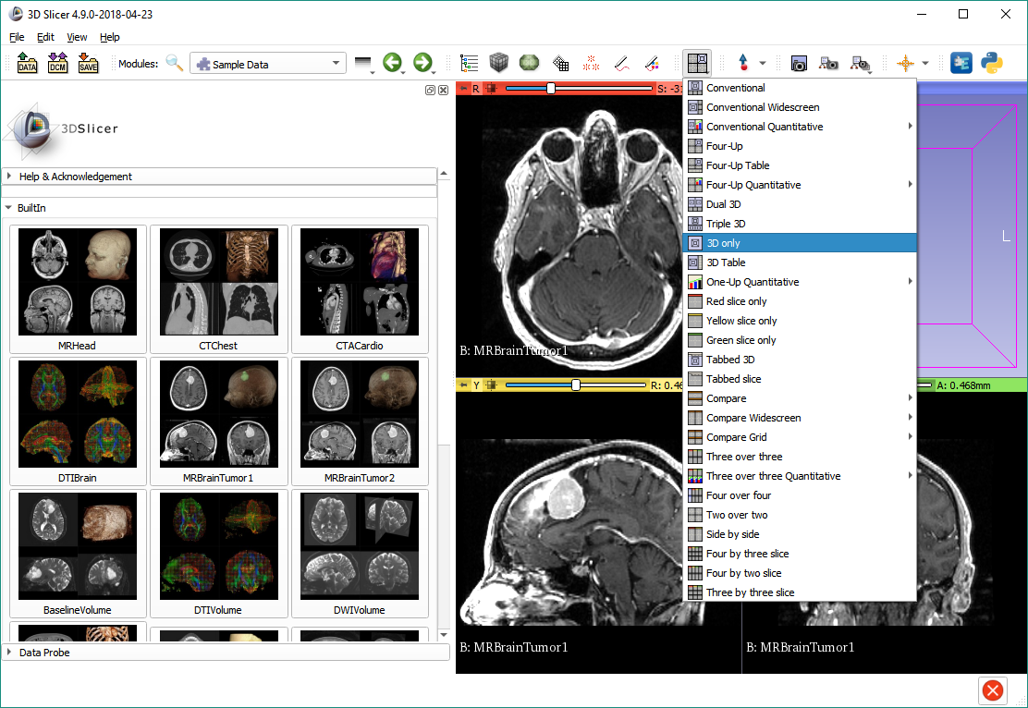
Switch to 3D only layout

Slide 19
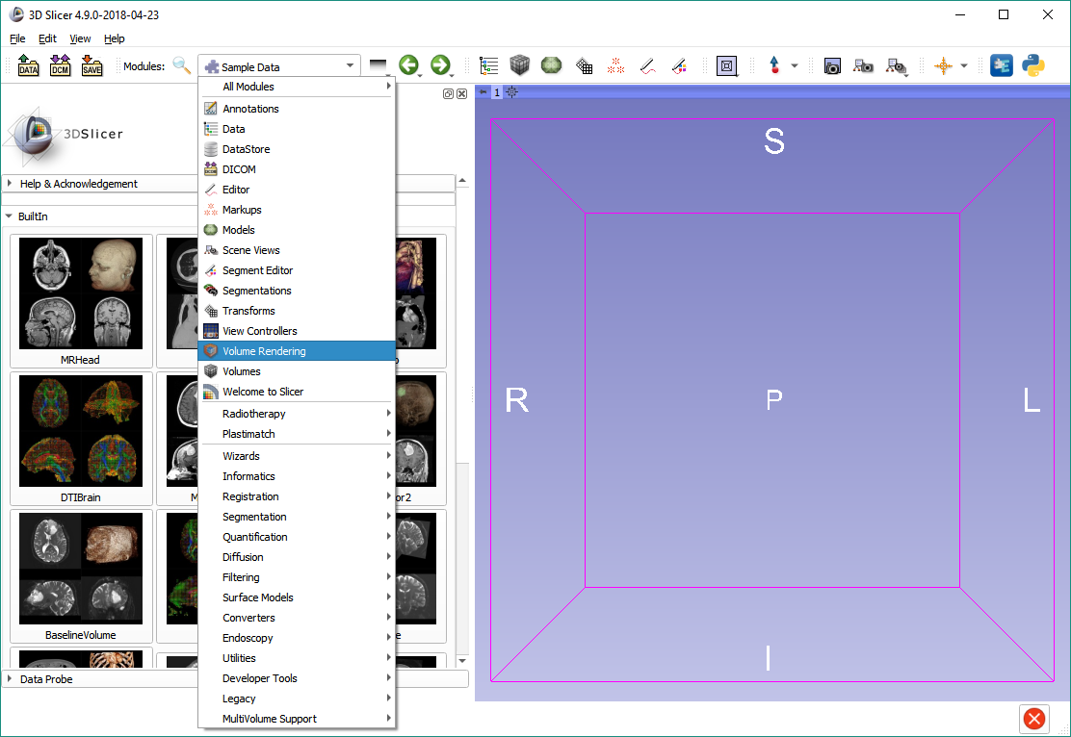
Switch to Volume Rendering

Slide 20
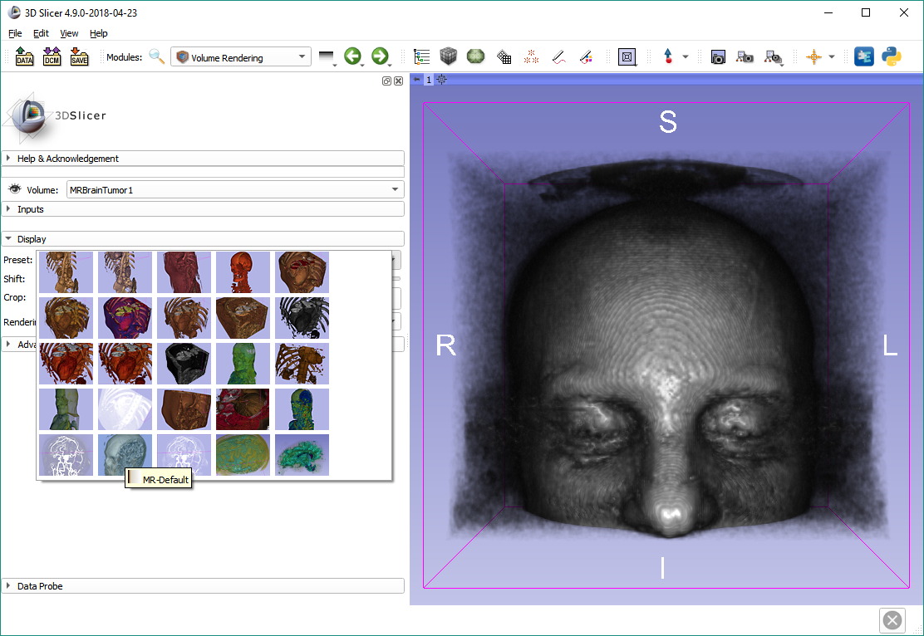
Show brain MRI in 3D
Click the eye icon to show MRBrainTumor1, then click the preset selector and choose MR-Default on the bottom.

Slide 21
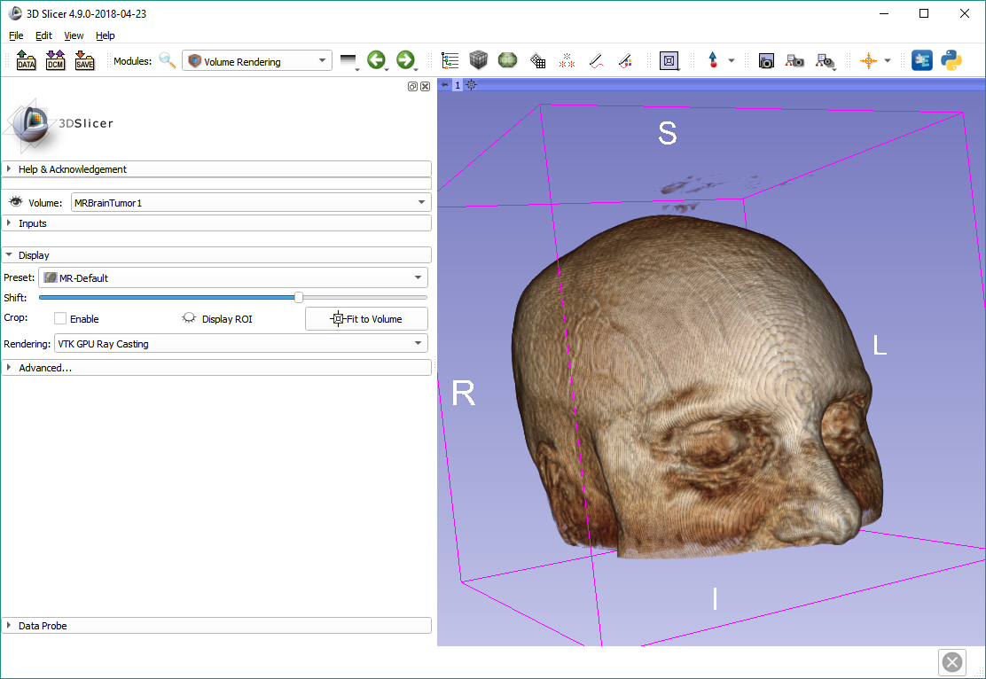
Show brain MRI in 3D
Make sure VTK GPU Ray Casting is the active rendering mode if your computer has a GPU.
Adjust the Shift slider to optimize display.

Slide 22
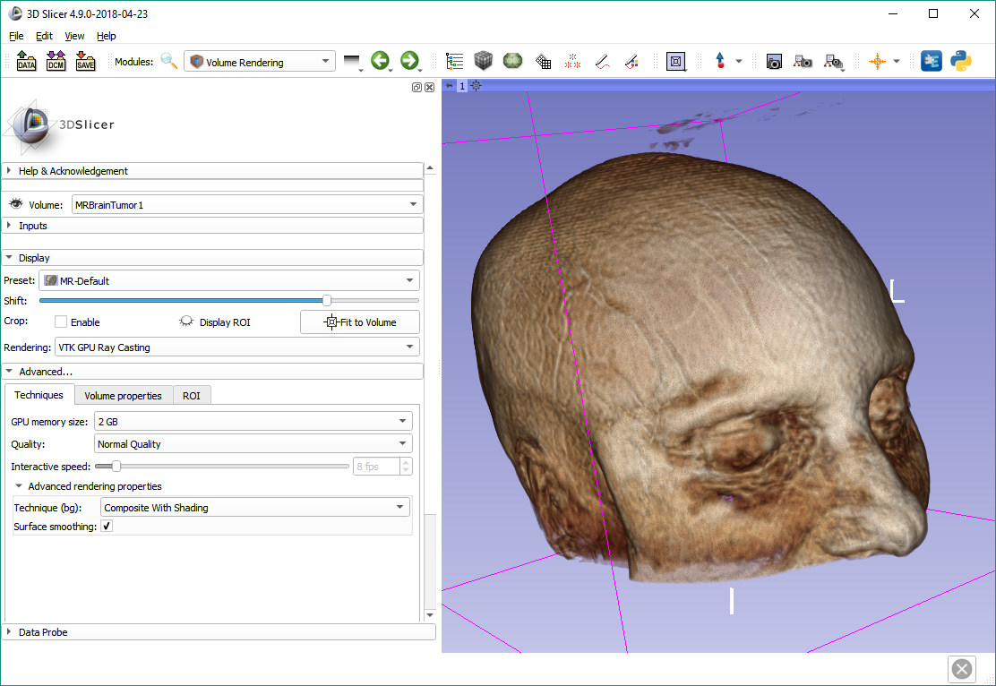
Show brain MRI in 3D
Optionally set the GPU memory size, and switch to Normal quality and enable Surface smoothing if your computer is fast enough.

Slide 23
Place first set of fiducials
Use the Create-and-Place fiducials button on the toolbar to place fiducials.
Place fiducials in the following order:
Corner of right eye (which is on the left)
Bridge of the nose
Corner of left eye

Slide 24
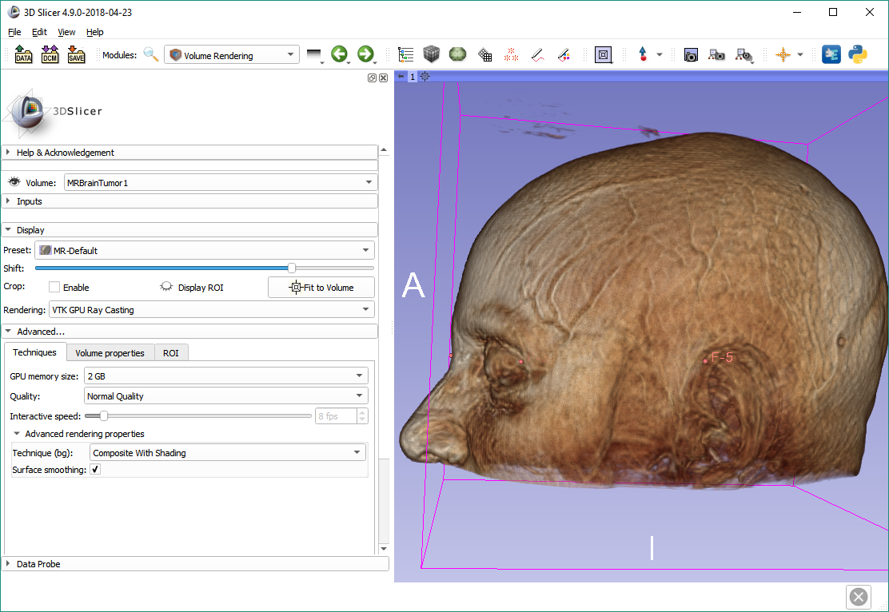
Place first set of fiducials
Place two more fiducials
4. Where the top of the right ear meets the head
5. Same for left ear

Slide 25
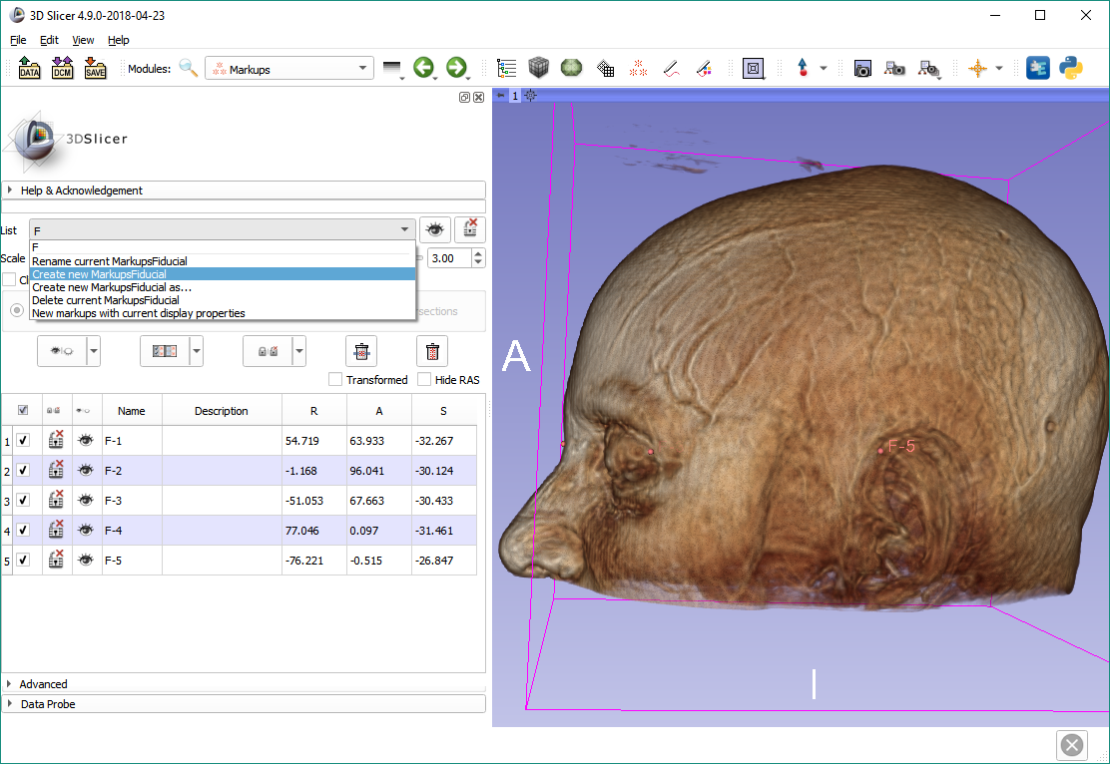
Create second set of fiducials
Switch to the Markups module using the toolbar. Create a new fiducial list for the second set.

Slide 26
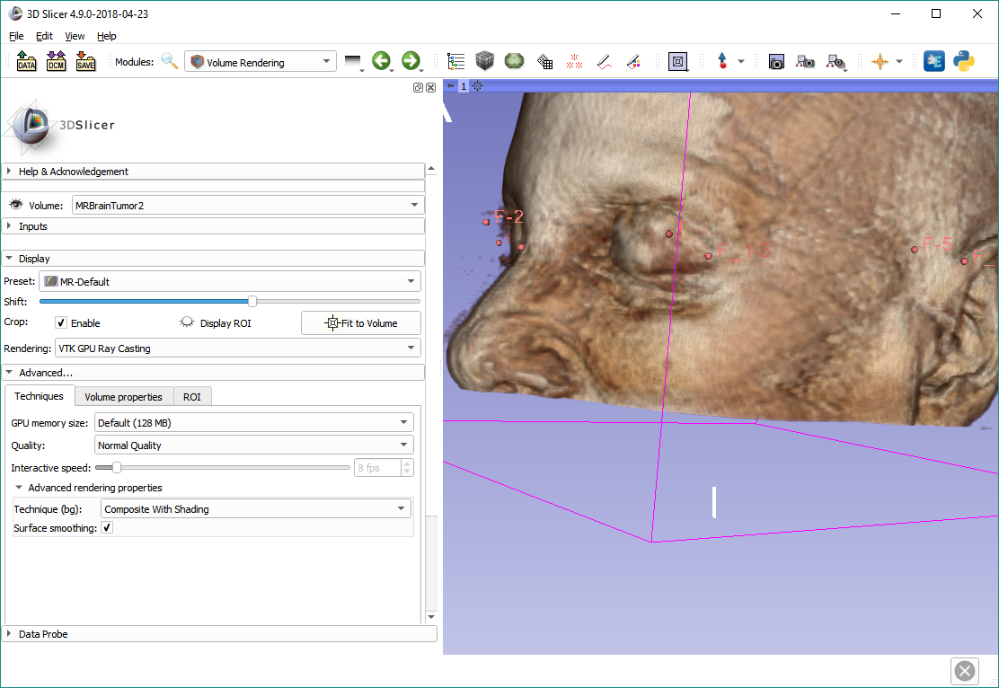
Place second set of fiducials
Hide MRBrainTumor1, switch to MRBrainTumor2, show it and set up display, then place the second set of fiducials the same way:
Corner of right eye (which is on the left)
Bridge of the nose
Corner of left eye
Where the top of the right ear meets the head
Same for left ear

Slide 27
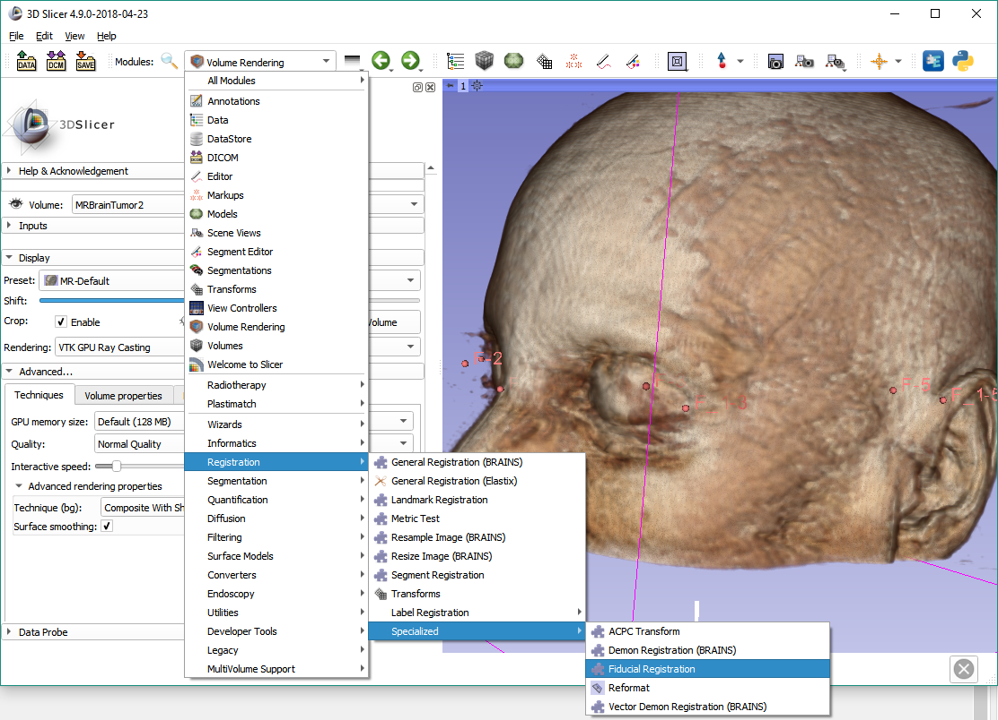
Switch to Fiducial Registration
Note that the Landmark Registration module can do the same task in a different way, as well as the Fiducial Registration Wizard in SlicerIGT.

Slide 28
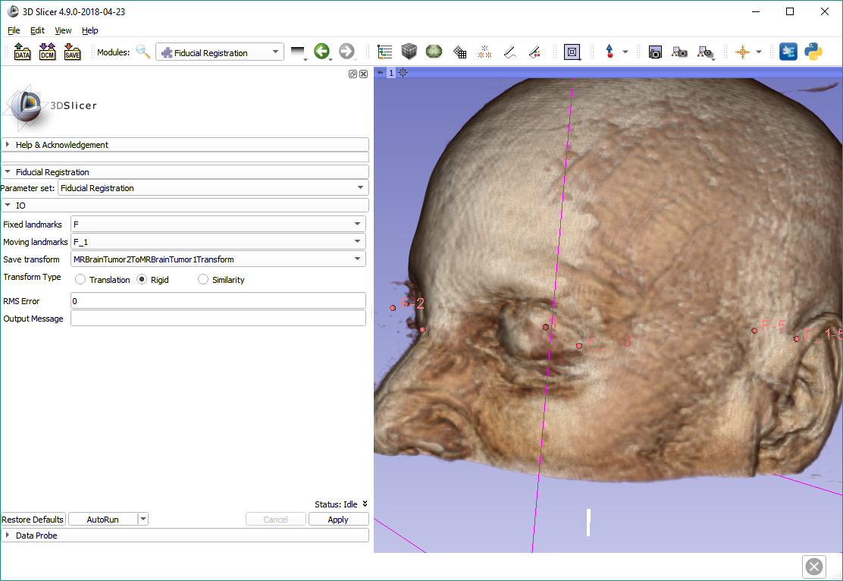
Perform fiducial registration
Make the marked selections and click Apply.

Slide 29
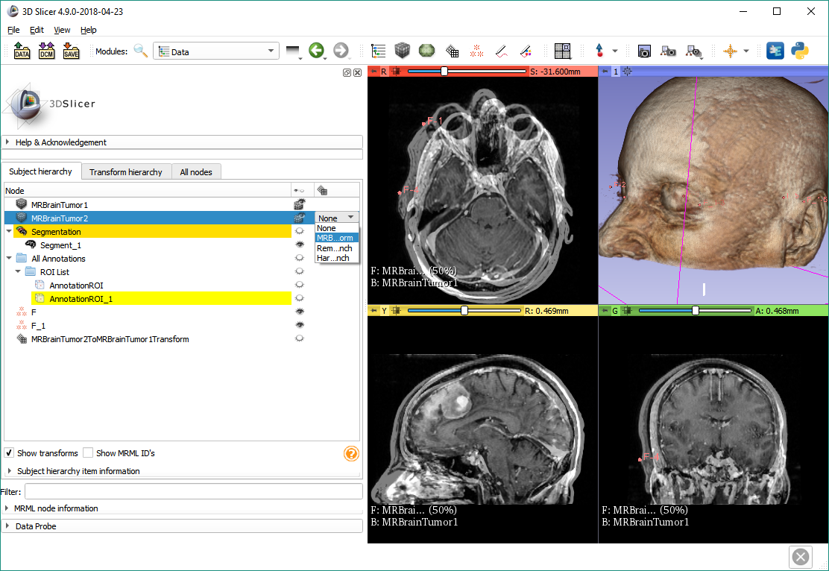
Apply transform on image
Switch back to Four-Up layout and show both volumes. Go to Data module. Double-click the transforms column for MRBrainTumor2, then select the just created transform.

Slide 30
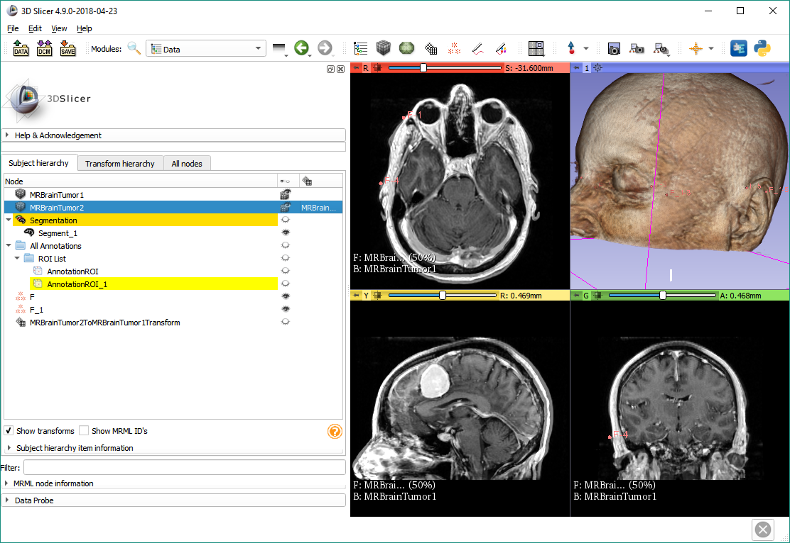
The two images are now aligned

Slide 31
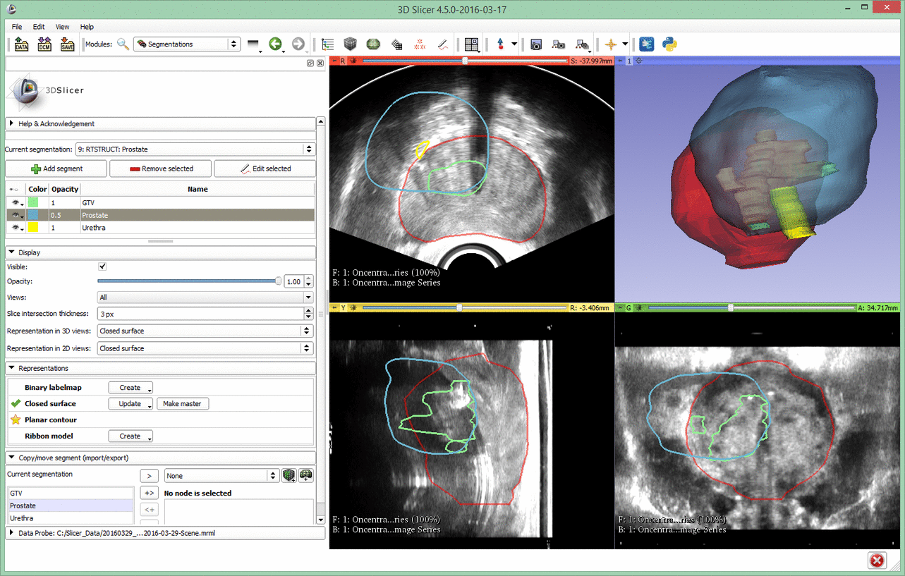
Segment Registration
Registration types: None / Rigid / Affine / Deformable

Slide 32
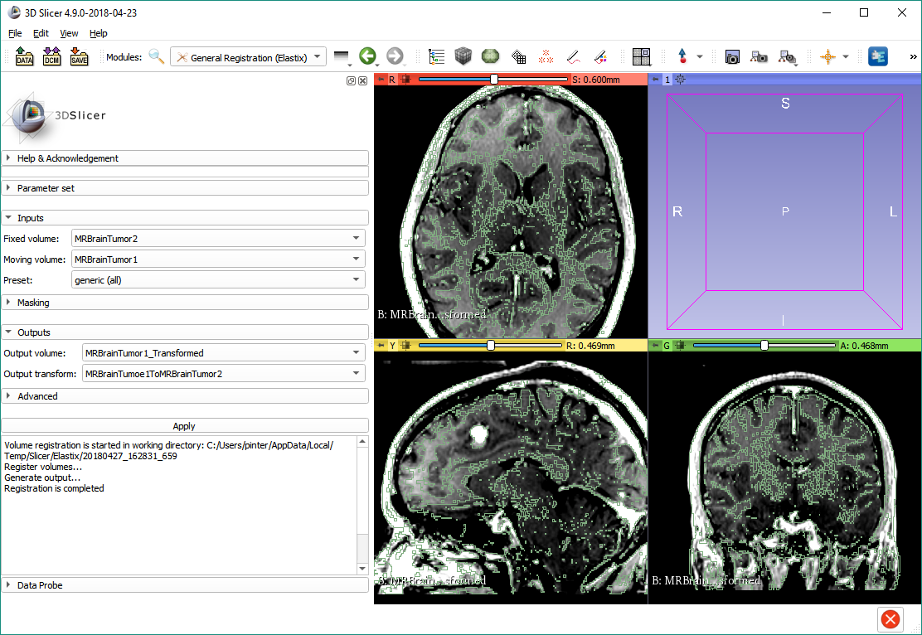
SlicerElastix

Slide 33
Thanks for participating!
More information on registration:
https://slicer.readthedocs.io/en/latest/user_guide/registration.html

Slide 34
Appendix

Slide 35
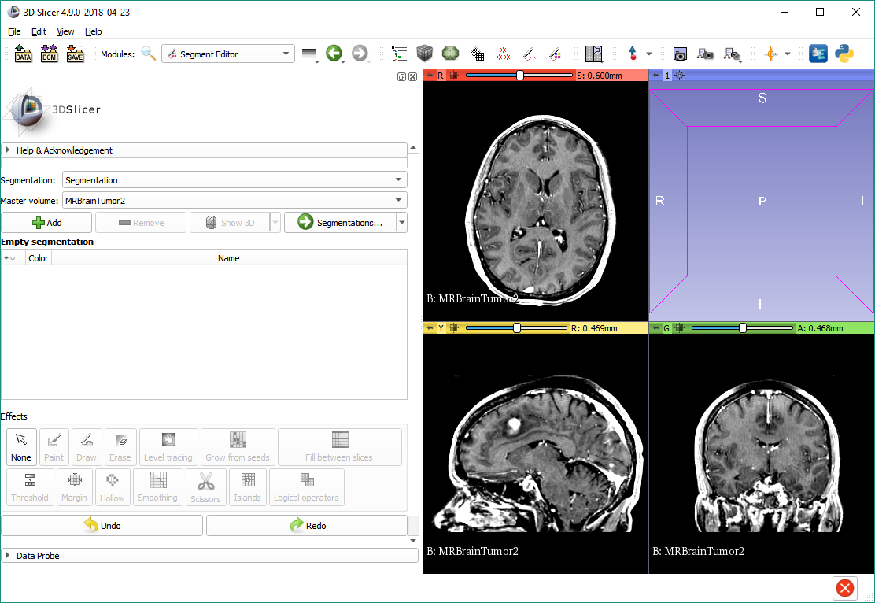
Alternative method of comparison
Switch to the Segment Editor module, make sure MRBrainTumor2 is selected as master volume, and add a new segment.

Slide 36
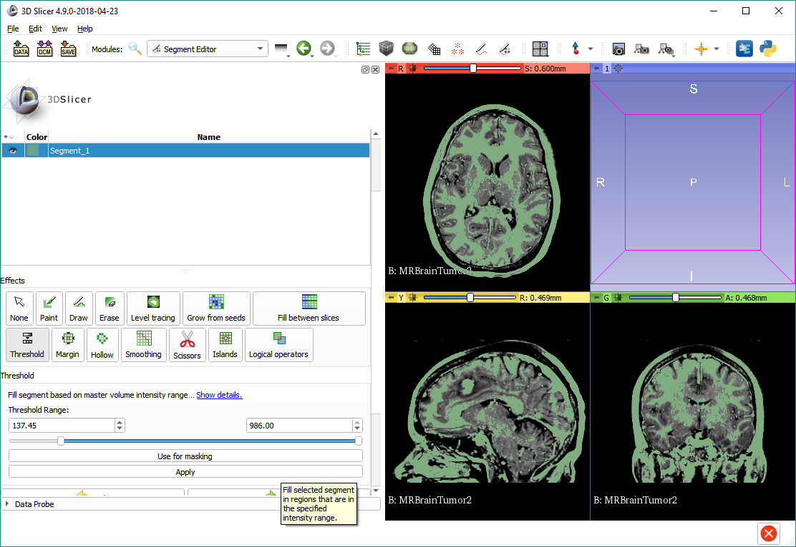
Alternative method of comparison
Select the ‘Threshold’ effect, adjust the threshold range so that the highlighted region contains structures in all regions and has a mostly clear border, then click Apply.

Slide 37
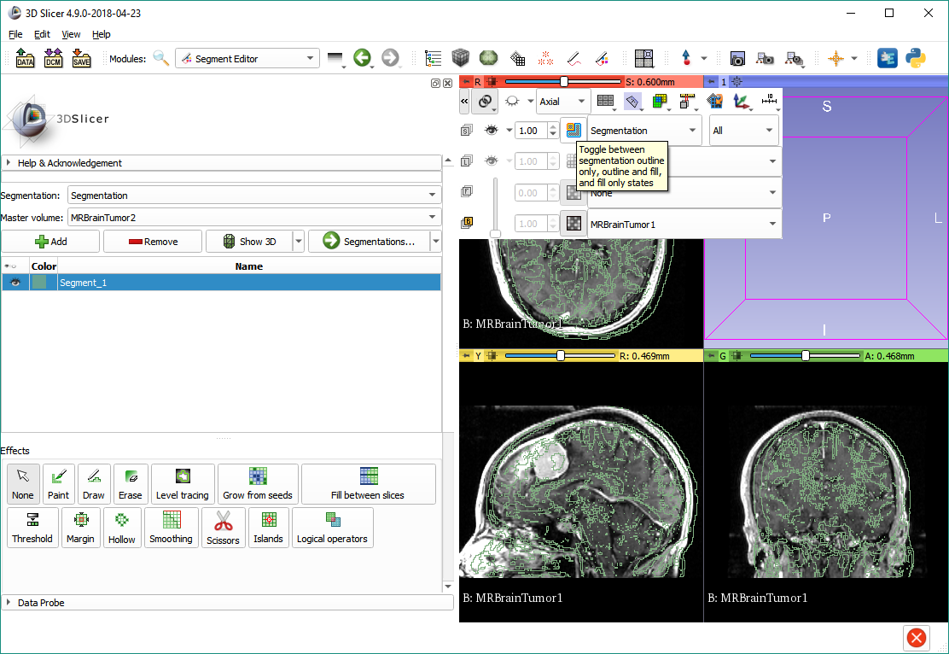
Alternative method of comparison
Link slice views, then change segmentation visualization to outline only (or you can keep the default if you prefer that).
Show MRBrainTumor1 in the background layer.

Slide 38
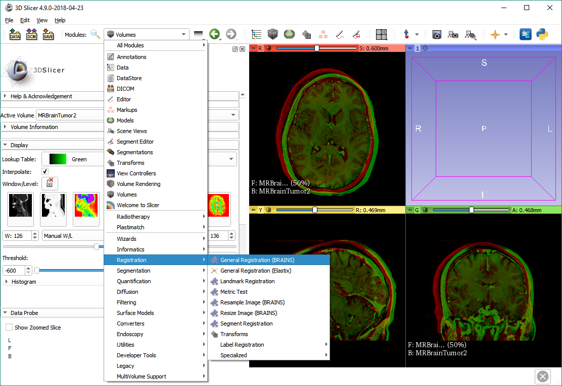
Register image using BRAINS
Switch to the ‘General Registration (BRAINS)’ module.

Slide 39
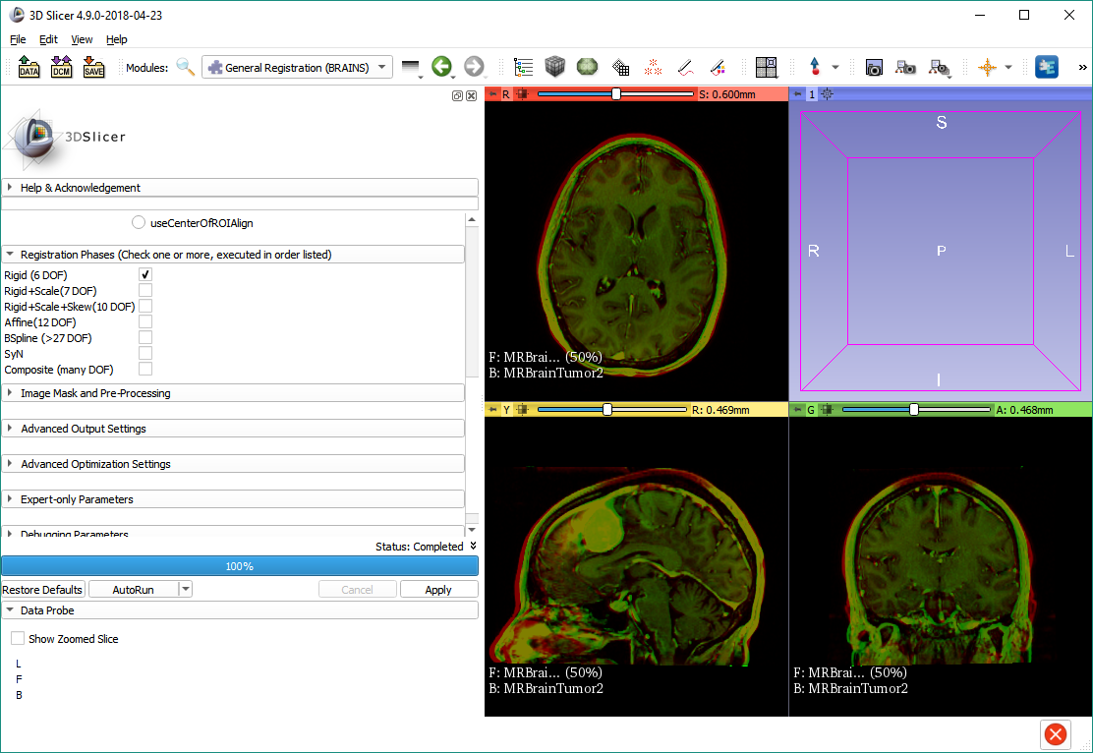
Register image using BRAINS
Scroll down in the module. Select the ‘Rigid (6 DOF)’ registration phase, then click Apply.

Slide 40
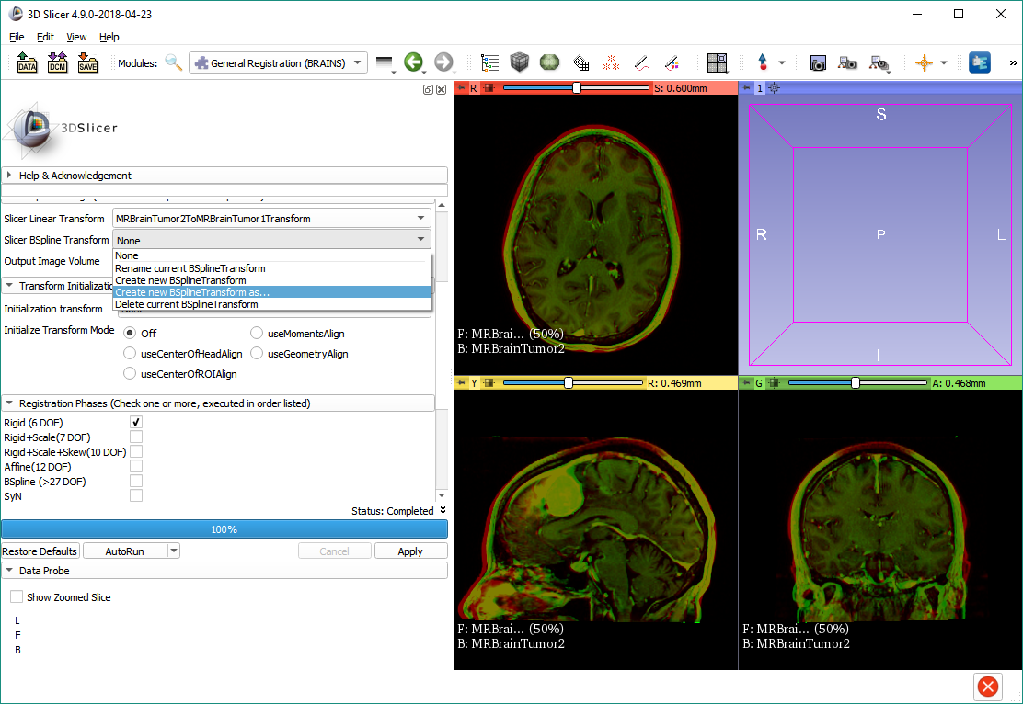
Deformable registration using BRAINS
Create new BSpline transform with the name ‘MRBrainTumor2ToMRBrainTumor1BSplineTransform’.

Slide 41
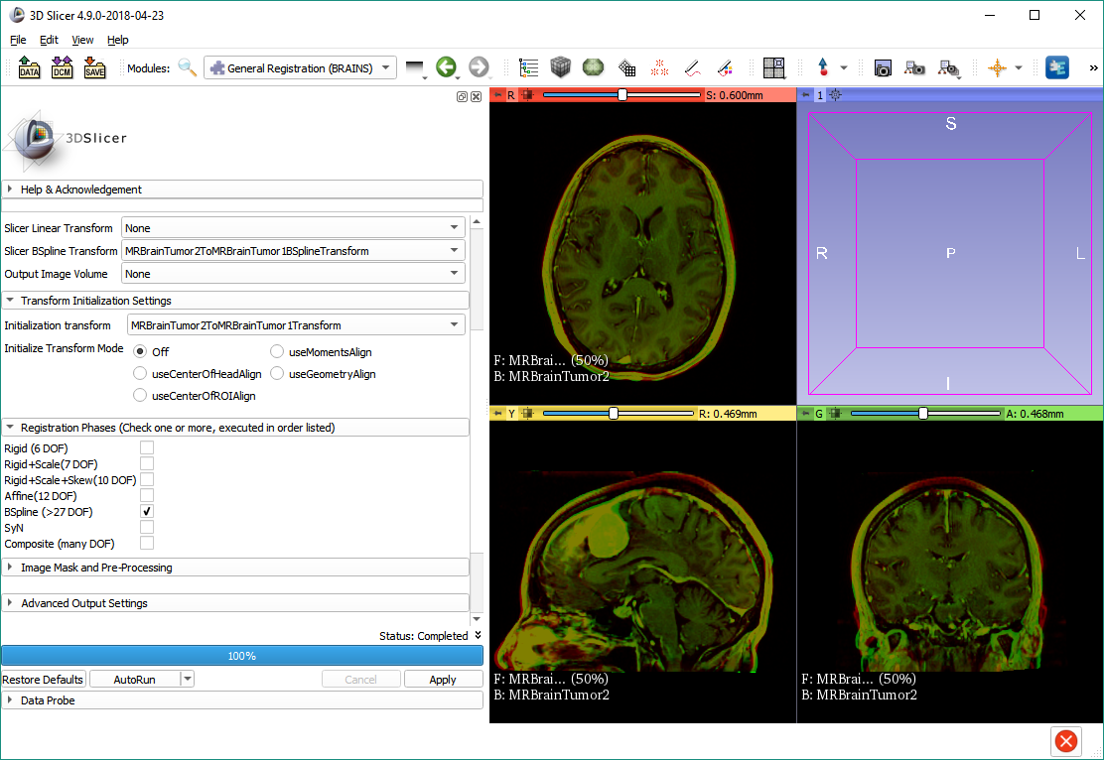
Deformable registration using BRAINS
Deselect linear transform and Rigid (6 DOF) phase. Select the linear transform as Initialization transform, check ‘BSpline (>27 DOF)’, then click Apply.

Slide 42
Deformable registration using BRAINS
Note that you can do both phases at the same time.
See how well the two images now match.

